Slide 1
Topics Modeling
Tuning LDA Model

Slide 2
Index
Cleaning Dataset
Preprocessing
Dataset splitting
Latent Dirichlet Allocation (LDA)
How does the LDA algorithm work?
LDA Corpus
LDA Probability Theory
LDA Model Parameters
How will LDA optimize the distributions?
First Iteration
Post Iterations

Slide 3
Index
PCA & LDA
LDA Summary
LDA Multi Core
LDA Tuning
LDA sklearn Gridsearch Tuning
LDA Gensim Tuning
Result Visualization
Prediction
Latent Semantic Analysis LSA

Slide 4
Cleaning Dataset
First will Concatenate the Title and abstract Columns in one
Clean Each text:
Lower case each word
Remove Spaces
Remove punctuations
Remove any non string or integer columns
Remove any digits year or percentages
Remove any word less than 3 characters

Slide 5
Preprocessing
Tokenize each text using {Gensim simple_preprocess or NLTK tokenizer}
Remove any stop English stop words
N grams each sentence
1
2, 3 using Genism Phraser

Slide 6
Preprocessing
Lemmatization each sentence where each word return to its root is called Lemma. A lemma (plural lemmas or lemmata) is the canonical form, dictionary form, or citation form of a set of words, take in consideration the morphological analysis of the words. To do so, it is necessary to have detailed dictionaries which the algorithm can look through to link the form back to its lemma.
For example, runs, running, ran are all forms of the word run, therefore run is the lemma of all these words.
Disable the morphological analysis as some word may be meaningless
Used spacy to load English core tagging dictionary

Slide 7
Dataset splitting
Used train_test_split from sklearn to split dataset to
20% test set
80% trainset
Now we have a for each sentence a clean list of words or tuple of n-grams, but we cant pass it to any model like this, so used gensim.corpora to make a corpus for each word with index

Slide 8
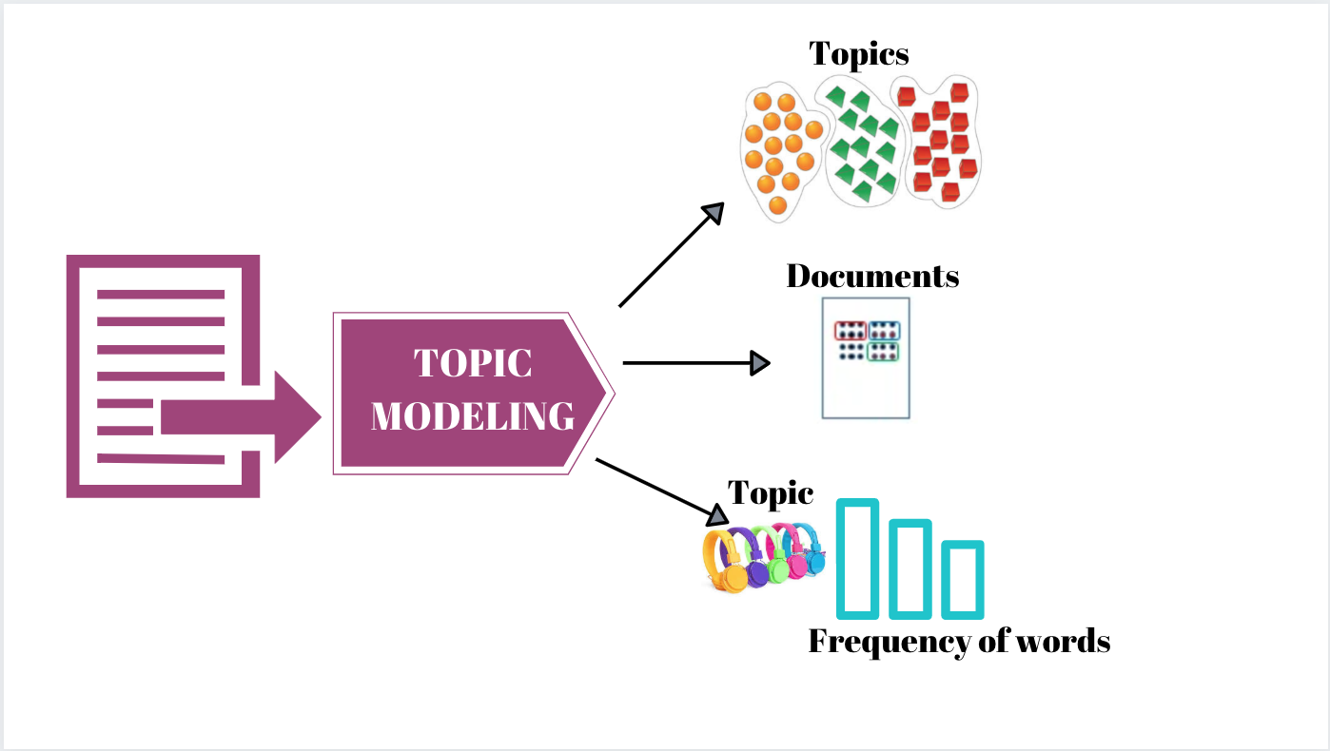
Latent Dirichlet Allocation (LDA)
Latent Dirichlet Allocation (LDA) is one of the ways to implement Topic Modelling. It is a generative probabilistic model in which each document is assumed to be consisting of a different proportion of topics.

Slide 9
How does the LDA algorithm work?
For each document, randomly initialize each word to a topic amongst the K topics where K is the number of pre-defined topics.
For each document d:
For each word w in the document, compute:
P(topic t| document d): Proportion of words in document d that are assigned to topic t
P(word w| topic t): Proportion of assignments to topic t across all documents from words that come from w.
Reassign topic T’ to word w with probability p(t’|d)*p(w|t’) considering all other words and their topic assignments
The last step is repeated multiple times till we reach a steady state where the topic assignments do not change further. The proportion of topics for each document is then determined from these topic assignments.

Slide 10
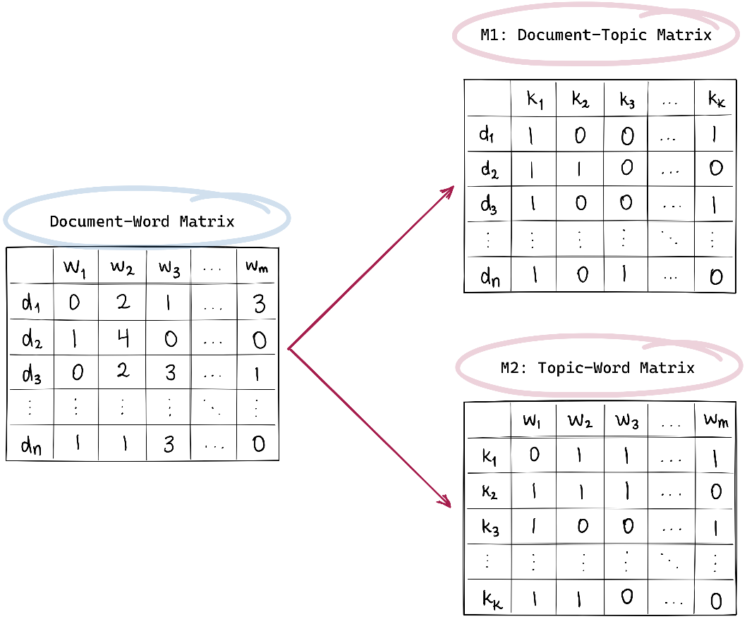
LDA Corpus
A corpus is the collection of documents, can be represented as a document-word (or document term matrix) also known as DTM.

Slide 11
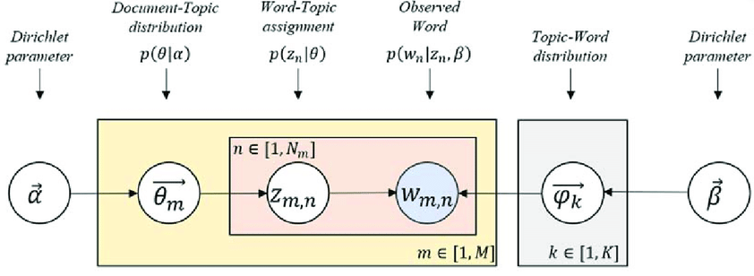
LDA Probability Theory
According to LDA, every word is associated (or related) with a latent (or hidden) topic, which here is stated by Z. Now, this assignment of Z to a topic word in these documents gives a topic word distribution present in the corpus that is represented by theta (𝛳).
Notes:
The yellow box refers to all the documents in the corpus (represented by M). In our case, M = 5 as we have 5 documents.
Next, the peach color box is the number of words in a document, given by N
Inside this peach box, there can be many words. One of those words is w, which is in the blue color circle.

Slide 12
LDA Model Parameters
The LDA model has two parameters that control the distributions:
Alpha (ɑ) controls per-document topic distribution, and
Beta (ꞵ) controls per topic word distribution
And this prams we will try to tune them
To summarize:
M: is the total documents in the corpus
N: is the number of words in the document
w: is the Word in a document
z: is the latent topic assigned to a word
theta (𝛳): is the topic distribution
LDA model s parameters: Alpha (ɑ) and Beta (ꞵ)

Slide 13
How will LDA optimize the distributions?
To find the most optimal representation of the Document-Topic matrix and the Topic-Word matrix to find the most optimized Document-Topic distribution and Topic-Word distribution.
LDA assumes that documents are a mixture of topics and topics are a mixture of words so LDA backtracks from the document level to identify which topics would have generated these documents and which words would have generated those topics.
our corpus that had 5 documents (D1 to D5) and with their respective number of words:
D1 = (w1, w2, w3, w4, w5, w6, w7, w8)
D2 = (w`1, w`2, w`3, w`4, w`5, w`6, w`7, w`8, w`9, w`10)
D3 = (w“1, w“2, w“3, w“4, w“5, w“6, w“7, w“8, w“9, w“10, w“11, w“12, w“13, w“14 w“15)

Slide 14
First LDA iteration
In the first iteration, it randomly assigns the topics to each word in the document. The topics are represented by the letter k. So, in our corpus, the words in the documents will be associated with some random topics like below:
D1 = (w1 (k5), w2 (k3), w3 (k1), w4 (k2), w5 (k5), w6 (k4), w7 (k7), w8(k1))
D2 = (w`1(k2), w`2 (k4), w`3 (k2), w`4 (k1), w`5 (k2), w`6 (k1), w`7 (k5), w`8(k3), w`9 (k7), w`10(k1))
D3 = (w“1(k3), w“2 (k1), w“3 (k5), w“4 (k3), w“5 (k4), w“6(k1),…, w“13 (k1), w“14(k3), w“15 (k2))
This gives the output as Documents with the composition of Topics and Topics composing of words:
The documents are the mixture of the topics:
D1 = k5 + k3 + k1 + k2 + k5 + k4 + k7+ k1
D2 = k2 + k4 + k2 + k1 + k5 + k2 + k1+ k5 + k3 + k7 + k1
D3 = k4 + k5 + k3 + k6 + k5 + k3 + … + k3+ k7 + k1

Slide 15
First LDA iteration
The topics are the mixture of the words:
K1 = w3 + w8 + w`4 + w`6 + w’10 + w“2 + w“6 + … + w“13 + w“`12 + w““1 + w““5
K2 = w4 + w`1 + w`3 + w“15 + …. + w““3 + …
K3 = w2 + w’8 + w“1 + w“4 + w“14 + w“`3 + w“`6 + … + w“`10 + w““32 + …
Similarly, LDA will give the word combinations for other topics.

Slide 16
Post LDA iterations
After the first iteration, LDA does provide the initial document- topic and topic-word matrices. The task at hand is to optimize these obtained results which LDA does by iterating over all the documents and all the words.
LDA makes another assumption that all the topics that have been assigned are correct except the current word. So, based on those already-correct topic-word assignments, LDA tries to correct and adjust the topic assignment of the current word with a new assignment for which:

Slide 17
Post LDA iterations
LDA will iterate over: each document ‘D’ and each word ‘w’
How would it do that? It does so by computing two probabilities: p1 and p2 for every topic (k) where:
P1: proportion of words in the document (D) that are currently assigned to the topic (k)
P2: is the proportion of assignments to the topic(k) over all documents that come from this word w. In other words, p2 is the proportion of those documents in which the word (w) is also assigned to the topic (k)
The formula for p1 and p2 is:
P1 = proportion (topic k / document D) ,and
P2 = proportion(word w / topic k)

Slide 18
Post LDA iterations
Now, using these probabilities p1 and p2, LDA estimates a new probability, which is the product of (p1*p2), and through this product probability, LDA identifies the new topic, which is the most relevant topic for the current word.
Reassignment of word ‘w’ of the document ‘D’ to a new topic ‘k’ via the product probability of p1 * p2
Now, the LDA is performed for a large number of iterations for the step of choosing the new topic ‘k’ until a steady-state is obtained. The convergence point of LDA is obtained where it gives the most optimized representation of the document-term matrix and topic-word matrix.
This completes the working and the process of Latent Dirichlet Allocation.
Now, before moving on to the implementation of LDA, here’s one last thing

Slide 19
PCA & LDA
Topic Modeling is similar to Principal Component Analysis (PCA). You may be wondering how is that? Allow me to explain.
So, PCA is a dimensionality reduction technique, right? And, it is used for data having numerical values. It is the linear combination of variables from which components are derived that are used to build the model. PCA works by breaking or decomposing a larger value (i.e. a singular value) into smaller values to reduce the dimensions.
LDA operates in the same way as PCA does. LDA is applied to the text data. It works by decomposing the corpus document word matrix (the larger matrix) into two parts (smaller matrices): the Document Topic Matrix and the Topic Word. Therefore, LDA like PCA is a matrix factorization technique.

Slide 20
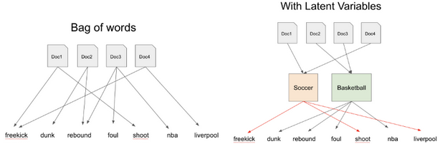
PCA & LDA
Let’s say we have the following corpus of documents having the tokenized words freekick, dunk, rebound, foul, shoot, NBA, Liverpool as below:

Slide 21
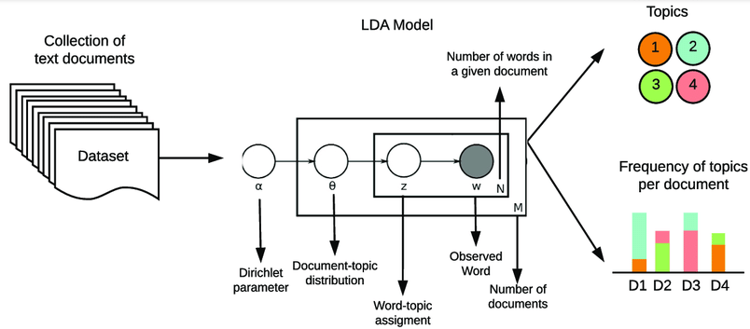
LDA Summary
Does two tasks:
finds the topics from the corpus,
assigns these topics to the document present within the same corpus.

Slide 22
LDA Multi Core
With all this probabilistic operations on each word and topic for each doc it will slow the performance so using multi core LDA which Using all CPU cores to parallelize and speed up model training.

Slide 23
LDA Tuning
LDA lib comes in 2 packages
sklearn
Gensim
Each one has it’s own parameters to tune it
Will use sklearn Gridsearch for LDA sklearn And a naïve for loops for Gensim one

Slide 24

LDA sklearn Gridsearch Tuning
Our measure score here will be Perplexity
is the measure of how well a model predicts a sample, used by convention in language modeling, is monotonically decreasing in the likelihood of the test data,
is algebraically equivalent to the inverse of the geometric mean per-word likelihood. A lower perplexity score indicates better generalization performance,
is equivalent to the inverse of the geometric mean, a lower perplexity implies data is more likely. As such, as the number of topics increase, the perplexity of the model should decrease.
Best Hyper Parameters :

Slide 25
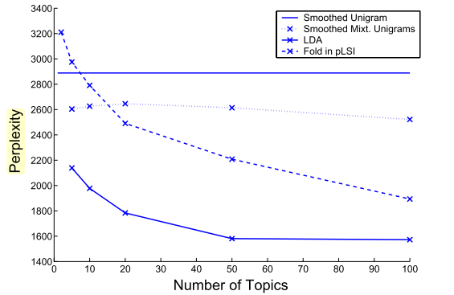
LDA sklearn Gridsearch

Slide 26

LDA Gensim Tuning
Our score here is Coherence measures score a single topic by measuring the degree of semantic similarity between high scoring words in the topic.
These measurements help distinguish between topics that are semantically interpretable topics and topics that are artifacts of statistical inference.
Best Hyper Parameters :

Slide 27
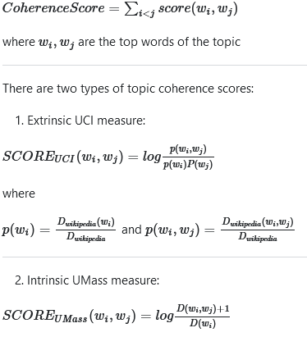
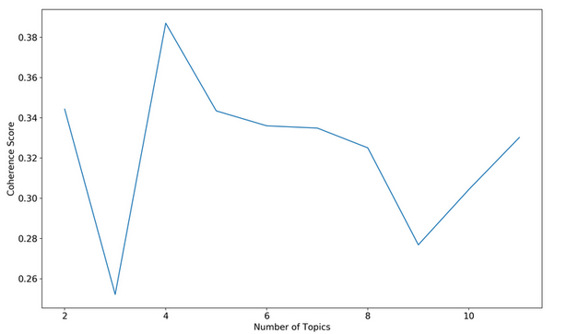
LDA Gensim Tuning
With the coherence score seems to keep increasing with the number of topics, it may make better sense to pick the model that gave the highest CV before
Notes:
https://www.researchgate.net/publication/333865994_Yoga-Veganism_Correlation_Mining_of_Twitter_Health_Data

Slide 28
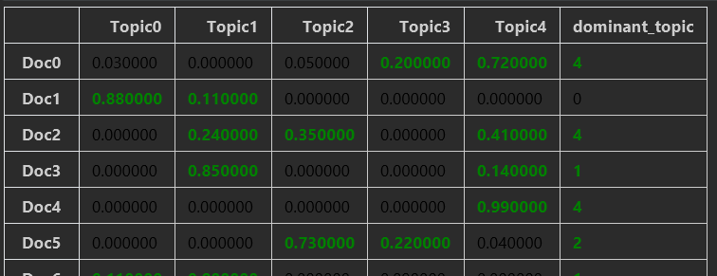
Result Visualization (Doc&Topic)
We Set the range number of topics from 5 to 10 (not 3)
The visualization using the word cloud to see most effective word on each topic from sklearn model with count vectorizer
Building a data frame of prediction probability for the training corpus

Slide 29
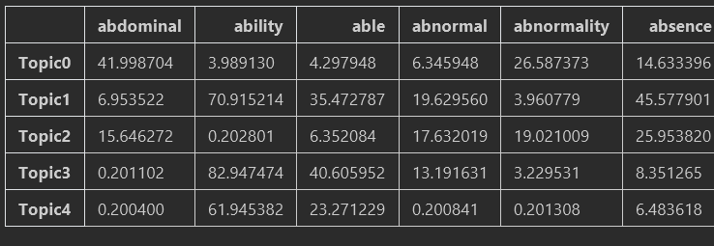
Result Visualization (Topic&Words)
Visualize across word and the topic

Slide 30
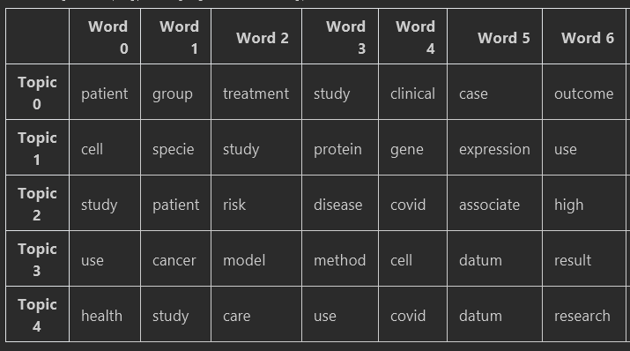
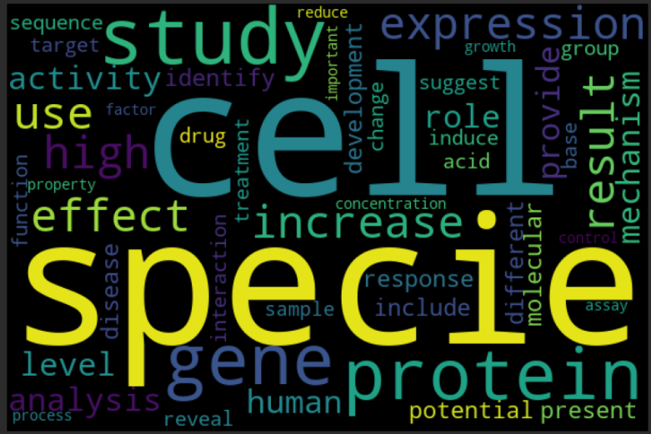
Result Visualization (Tpic WordCloud)
Top words for topics
WordColud for topic 0

Slide 31
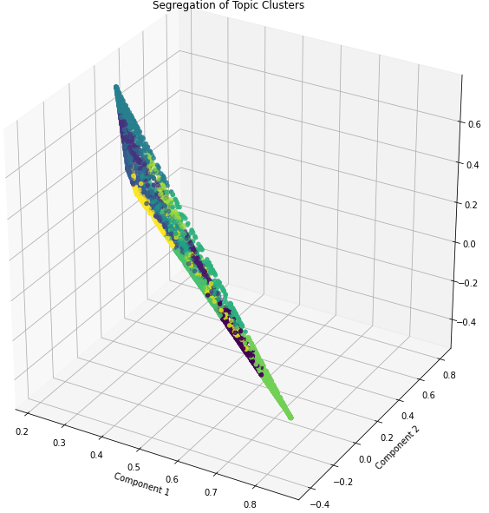
Result Visualization (Truncated SVD)
We can reduction our prediction probability using Truncated SVD, to visualize it in 3D Space
the singular values of the matrix A with rank r. We can find truncated SVD to A by setting all but the first k largest singular values equal to zero and using only the first k columns of U and V

Slide 32
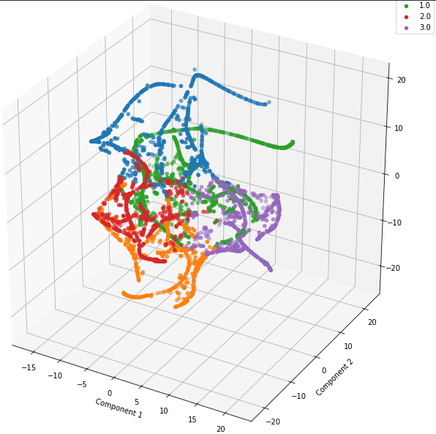
Result Visualization (TSNE)
Same with TSNE T-distributed Stochastic Neighbourhood Embedding (tSNE) is an unsupervised Machine Learning algorithm developed in 2008 by Laurens van der Maaten and to visualise the structure of high dimensional data in 2 or 3 dimensions

Slide 33
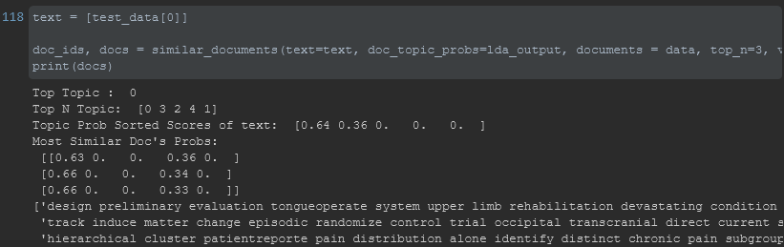
Prediction
After All this we can predict and get top n similar score
Using Euclidean Distance

Slide 34
Latent Semantic Analysis LSA
Is one of the foundational techniques used in topic modeling. The core idea is to take a matrix of documents and terms and try to decompose it into separate two matrices
A document-topic matrix
A topic-term matrix.
Includes matrix decomposition on the document-term matrix using Singular value decomposition.
It is typically used as a dimension reduction or noise-reducing technique
Notes:
https://www.analyticsvidhya.com/blog/2021/06/part-16-step-by-step-guide-to-master-nlp-topic-modelling-using-lsa/

